Slide 1
3 Paths to Discontinuous Innovation
Tim Kastelle
12 June 2012
CEEC Workshop on EEC

Slide 2
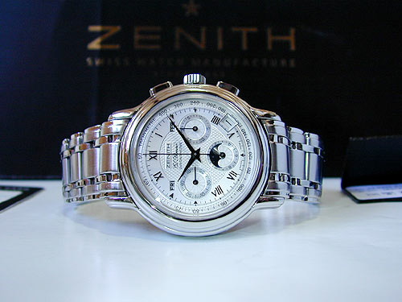

Slide 3
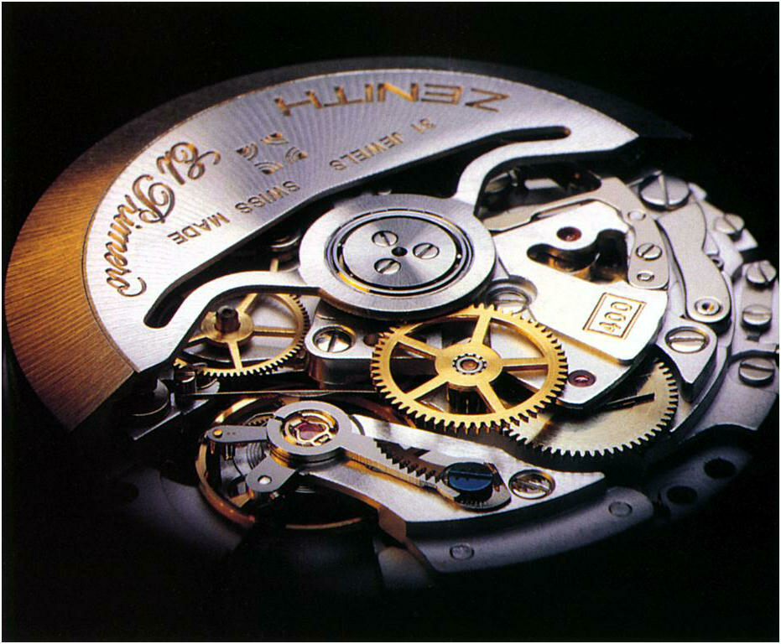

Slide 4
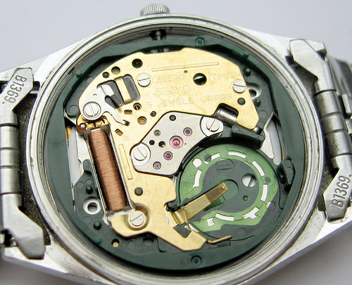

Slide 5
Path #1: Find a 10X Improvement
Quartz watches 10 times as accurate as the top of the line mechanical watches, for less than 1/10th of the cost
Question: what’s like quartz for comminution?

Slide 6
Why is the retirement age 65?

Slide 7
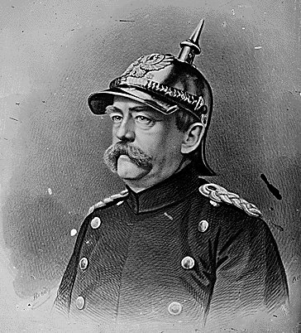

Slide 8
Life Expectancy
Germany 1880 – about 58 years (retirement age set at 65)
US 1935 – about 62 years (retirement age set at 65 too)
All the other countries that followed in the next decade <60 years

Slide 9
Life Expectancy at Birth (US)

Slide 10
So…
What was the biggest innovation that drove this change in life expectancy?

Slide 12
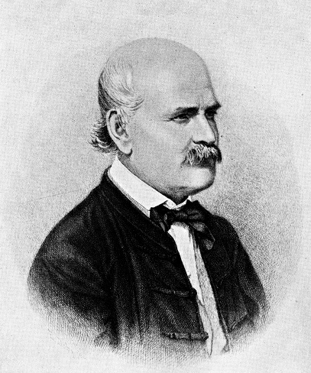

Slide 13
Medical Handwashing
First suggested – 1840s
First evidence that it works – 1850s
Germ theory of disease – 1860s
First use in surgery – 1870s
In widespread use – 1920s

Slide 15
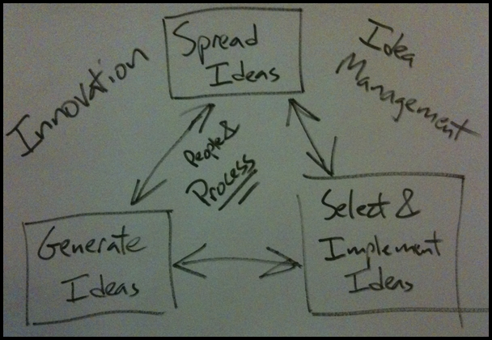

Slide 16
Ideas are often the
biggest innovations

Slide 17
Innovation always
changes behaviour

Slide 18
Path #2: Find a new idea
We focus too much on technological innovation – that’s only part of the story
Question: what is a new way to think of comminution? Or processing?

Slide 19
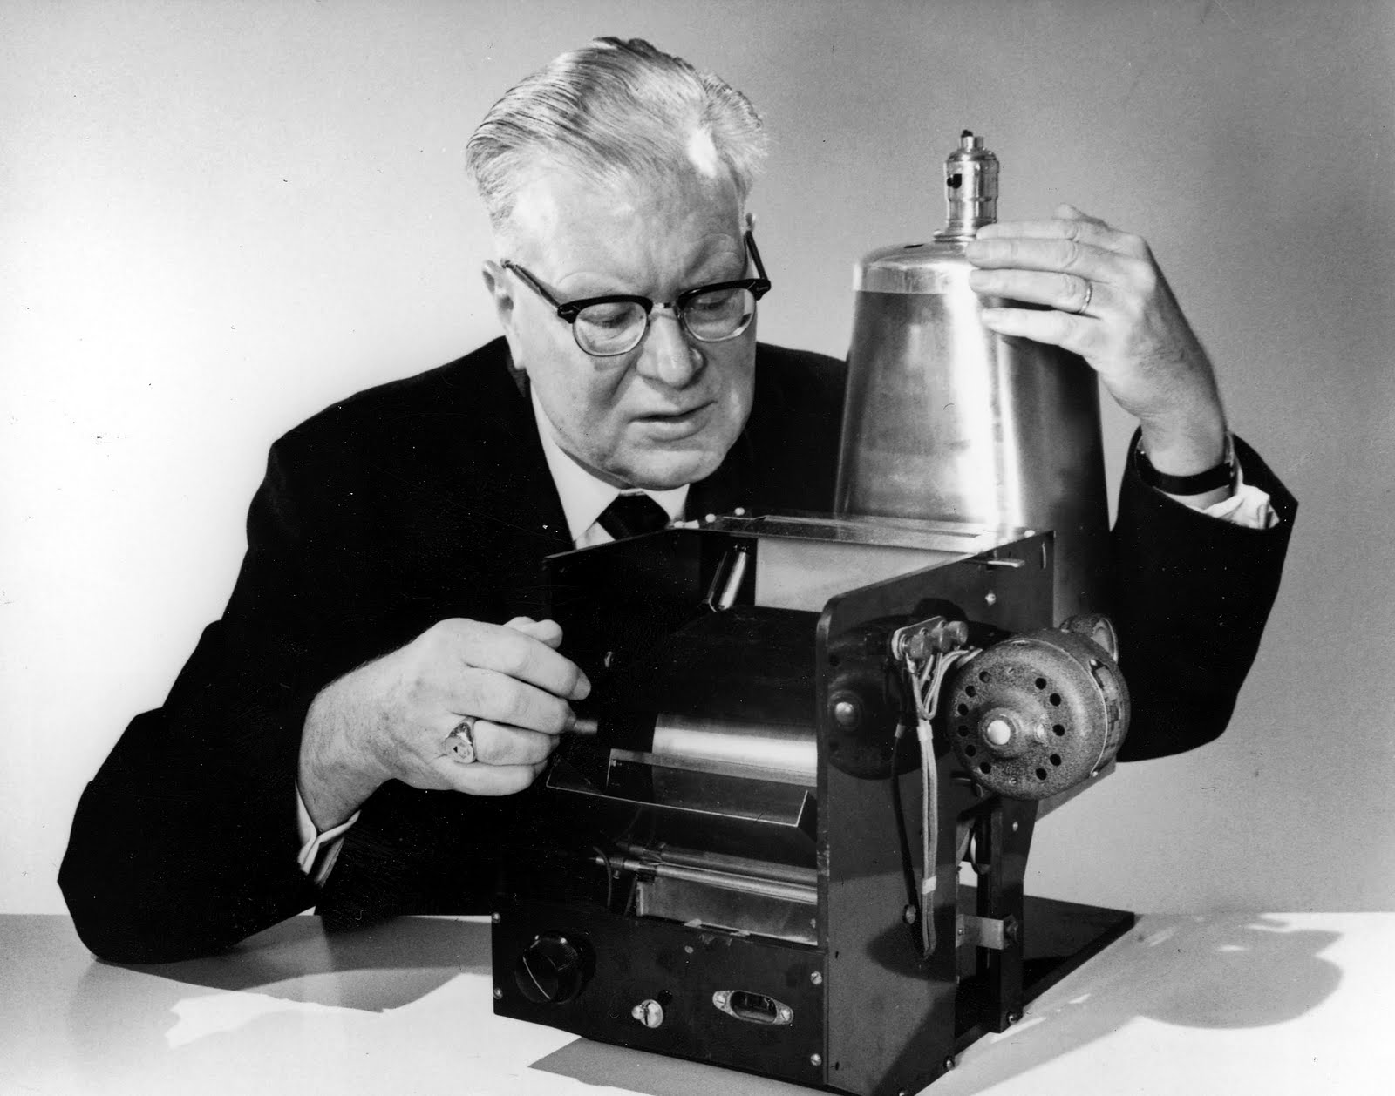
1936

Slide 20
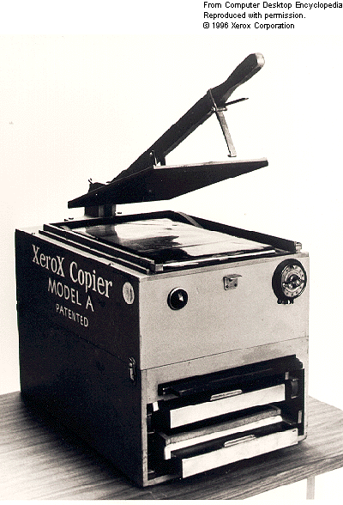
1950

Slide 21
Business Model Innovations in Copying
1950s – copies made by mimeograph or dry thermal processes – very poor quality, hard to archive
Equipment was inexpensive, money was made on supplies
90% of machines made < 100 copies per month

Slide 23
The Arrival of Xerox
Invention of xerography – much higher quality, longer lasting (Chester Carlson files patent in 1937)
Haloid Corp licenses patent, sells first Xerox machine in 1950
Problem: Xerox machines six times more expensive than competitive technology, cost per copy about the same
Kodak, GE, IBM and Arthur D. Little Consultants all concluded there was no market for Xerox machines

Slide 24
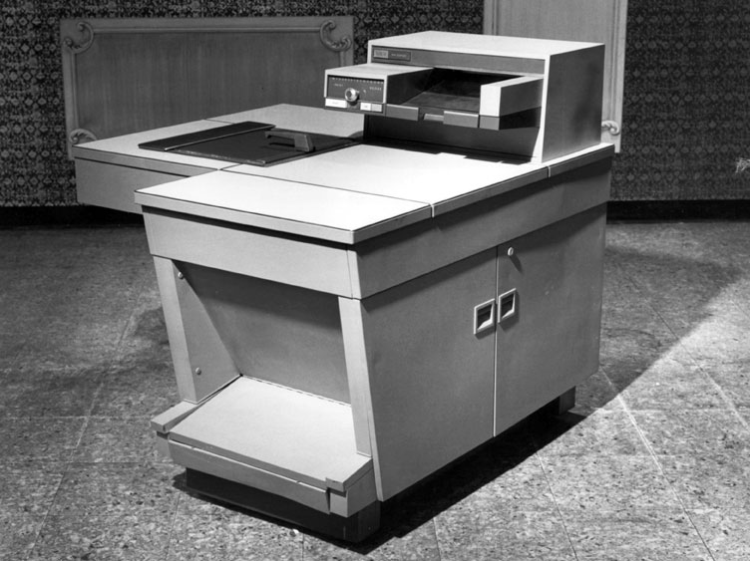
1959

Slide 25
The New Business Model
High volume users
Lease machines instead of selling them, includes 2000 copies per month, customers pay extra for all further copies
Improved quality and convenience led to average user making 2000 copies per day!
The more copies made, the more money Xerox makes

Slide 26
Dominant Logic of Xerox
More copies are better
New product innovations must lead to higher volume
Duplexing
Collating
Stapling
Copies per minute

Slide 27
The State of Play by the1970s
Xerox and Kodak dominate the market, selling nothing but high volume machines
Sales are made by internal sales force, service performed by internal service teams
Cost of equipment very high (no more leasing)
Small volume users either use older methods or go to copy centres

Slide 28
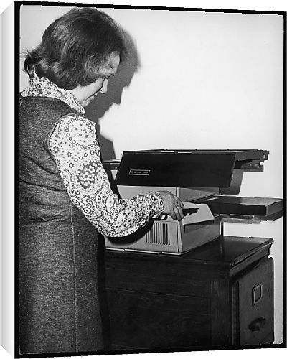

Slide 29
Another New Business Model
Cheap copiers, no features
Very high cost per copy, mediocre technology
Copiers sold through office supply stores
Sales and service outsourced

Slide 30
Competing Business Models

Slide 31
New Business Models for Disruptive Innovation
Choose a market segment whose needs are not being met
Focus on this segment, build competencies, increase skills
Use new competencies to expand into more profitable parts of the value chain or better market segments
Compete against large incumbents by changing the experience curve
Photocopiers - Xerox Market Share:
1975: 75%
1980: 42%
1985: 35%
Who has the big market share now? Canon and Ricoh

Slide 32
Path #3: Find a New Business Model
New business models start in niches (think: taxi drivers + Prius, or hydrogen-powered vehicles + bus fleets)
In terms of performance, they always look lousy at the start
Question: what would a new business model look like in processing? e.g. what happens if we stop competing on capital efficiency and start competing on processing efficiency?

Slide 33
Three Paths to Discontinuous Innovation
Find a 10X improvement in performance.
Find a new idea.
Find a new business model.

Slide 34
Thank you!
timkastelle.org/blog/

