Slide 1
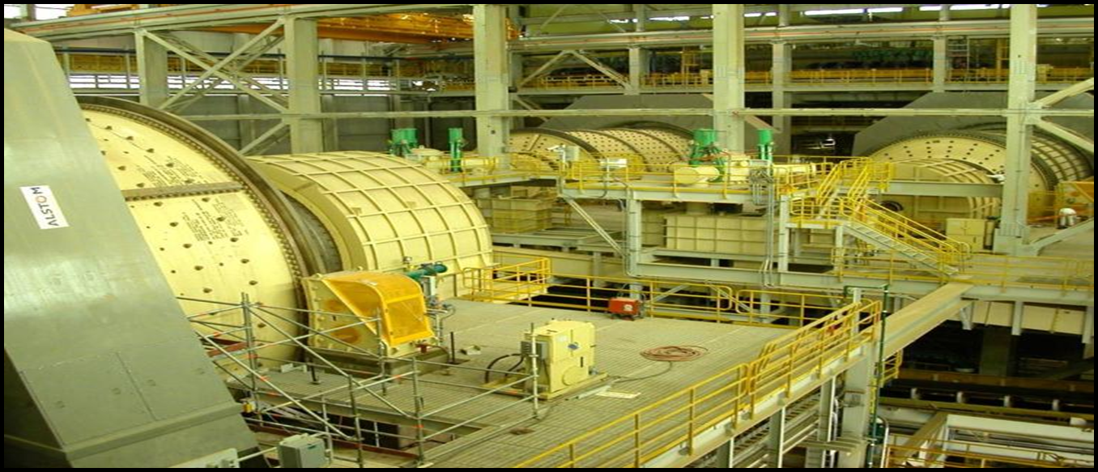
CEEC Workshop on Energy Efficient Comminution
Chris George
Senior Manager, Group RBO
12th June 2012

Slide 3
History of annual Cu production and grades
Notes:
Key message is decline in overall copper grade with rapidly increased demand. Key advances in smelting and hdromet technologies have enabled lower grade resources to be exploited but additional technology breakthroughs will be required, particularly in sulphide s, to exploit the expected future low grade deposits economically . At places like Escondida, this will be coming from increasingly deeper pits (+450m).
Extraction of Copper Sulphides is using the same base technology developed 50-100 years ago. Has relied on incremental improvements in flotation cell design and mill design but has basically been driven by larger and larger equipment to enable higher rates of processing to offset falling grade.

Slide 4
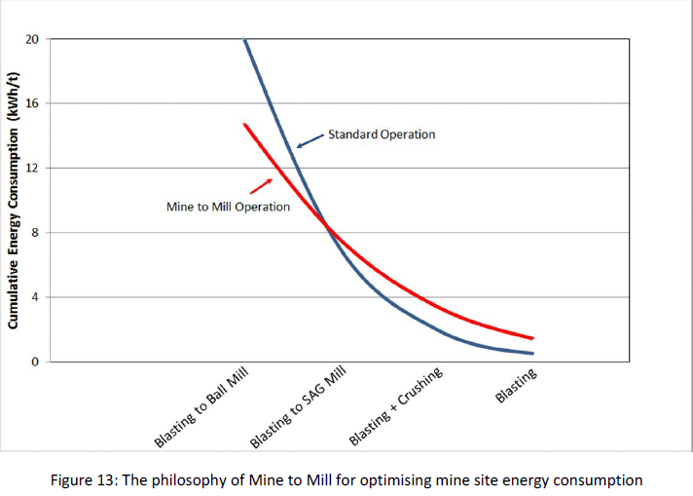
JKTech Review - Energy / Size Distribution
Grinding size sets the energy consumption – majority is in the milling steps
This can be traded off against blasting (chemical) energy

Slide 5
JKTech Review - Comminution Energy
Grinding accounts for the majority of energy consumption in the mining operation.
There is an opportunity cost in shifting rock size reduction upstream from the mill into the mining process.
Intensive blasting to Ball Mill feed size is possible but would not eliminate a screening and crushing step. An economic cut-off of about P80 50mm is indicated for ultra-high intensity blasting.
There is a limited potential of around 10% to reduce overall specific energy by moving from SABC circuits to HPGR/BM or Crushing/BM circuits. In many HPGR crushing circuits materials handling has become a major detrimental issue.
Novel breakage techniques involving high voltage electrical pulses, microwaves and ultrasonics have been investigated in the laboratory but none have yet progressed to industrial applications.

Slide 6
Some Thoughts
We all face the challenge of declining grades, deeper mines, higher capex and opex.
Energy is one cost driver but by no means the only one. A 50% reduction in comminution energy per se would certainly be welcome but may not be the paradigm shift we need.
Grinding more efficiently 98% of what we don’t want to grind at all does not seem to be the answer, particularly as that gangue then locks up water.
Water cost is high and getting higher. Water logistics is becoming a key differentiator between projects.
Our experience is that where we can AG milling beats SAG milling. Grinding balls aren’t cheap and can be equivalent to 30%-40% of the concentrator power costs.
Comminution is a means to an end. In base metals we are over dependent on flotation. We expend the greatest energy in fine grinding – hence high potential benefit in rejecting waste early and chasing coarser separation upstream.
Greater energy efficiency at the cost of increased circuit complexity may not be value adding. For BHPB scale is important – we are looking at 150,000 tpd modules for Escondida and favour single lines.
6

